Slide 1


Slide 2
GROUP MEMBERS
Hamaima Binte Altaf (172101)
Aimen Nawaz(172049)
Mahnoor Zahid(172061)
Izzah Tahir(172091)
Irum Mushtaq(172052)

Slide 3
GYM EDGE HEALTH AND FITNESS CENTER

Slide 4


Slide 5
Introduction
We all know health is a wealth. We do not need a fancy car, big apartment, a doctor degree without a health. Being healthy is a first thing we need to keep in mind. Because most of time our attitude depends on how we feel. Being healthy and fit gives us energy to do anything. Physical fitness is very necessary for a healthy and tension free life. Physical fitness includes diet, exercise and sleep. These three basic things have their own importance in each individual's life and everyone should be sensible with regard to these for a healthy life

Slide 6
Objectives
Develop a user friendly efficient computerized Gym Management system
An accurate system without any data redundancy.
Secured data storage for Authority end.
Secure the user ends data by providing each user’s own personal credentials.
A flexible system which can maneuver the customer-staff relationship in an effective manner.
To provide better graphical user interface.
Computerization can be helpful as means of saving time & money

Slide 7
MODULES
Administrative Module
User Module
Create, Update, Manage, Delete User
Creating Offer Plan
Manage User Enquiry through Email
Manage Owner Info
Applying for Package
Account Update
Phone and Email Address Verification on Sign Up
Enquiry to Authority

Slide 8
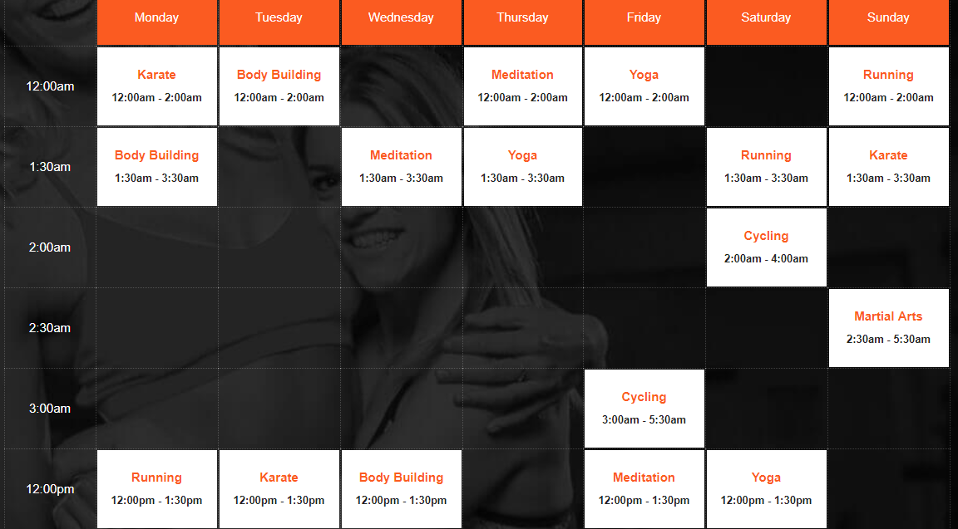
SCHEDULE

Slide 9
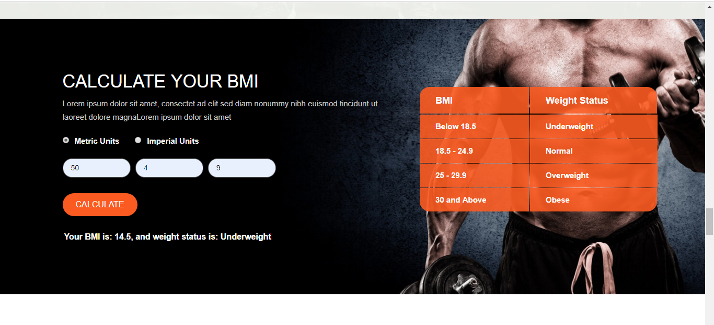
BMI CALCULATOR

Slide 10
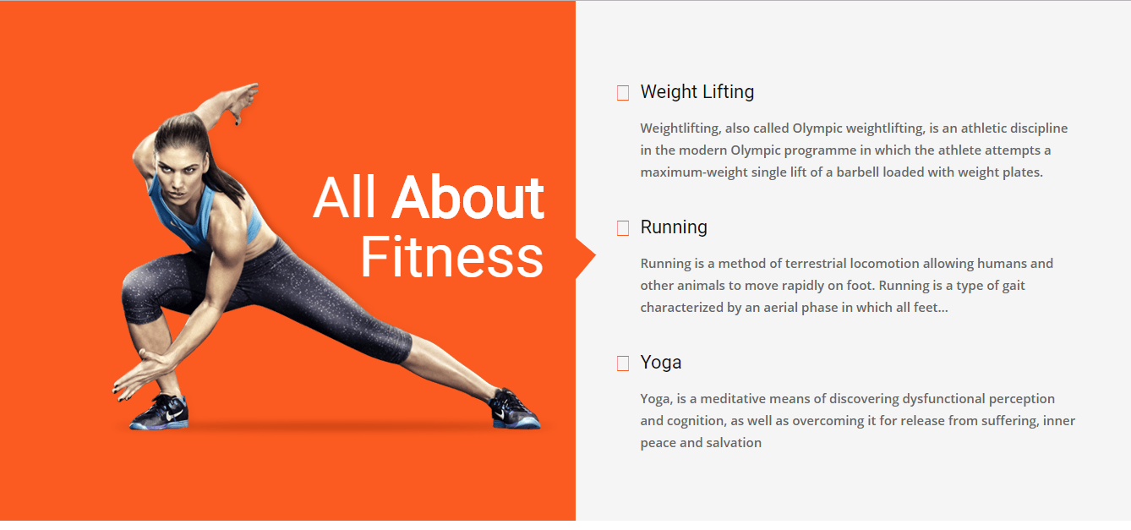
It’s all about your Fitness

Slide 11
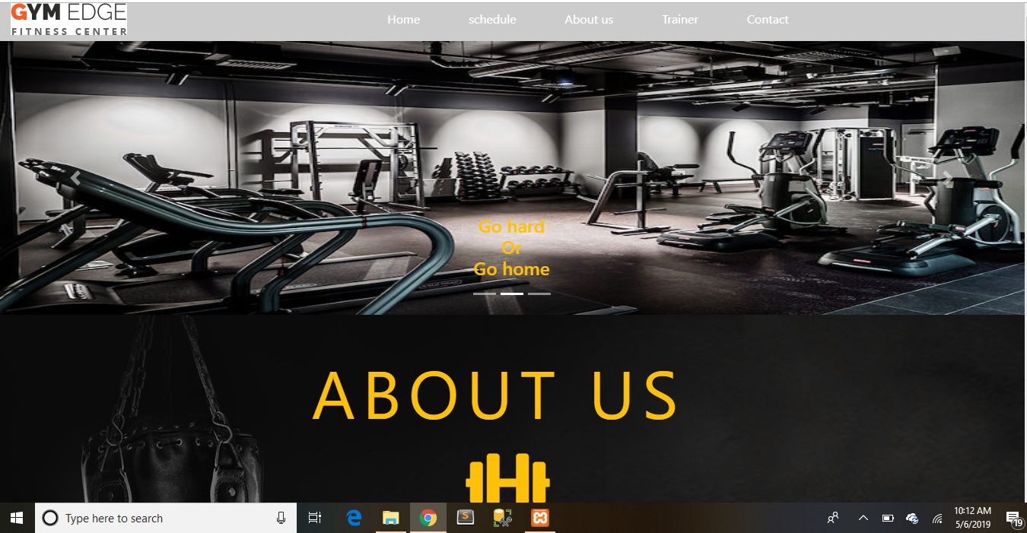

Slide 12
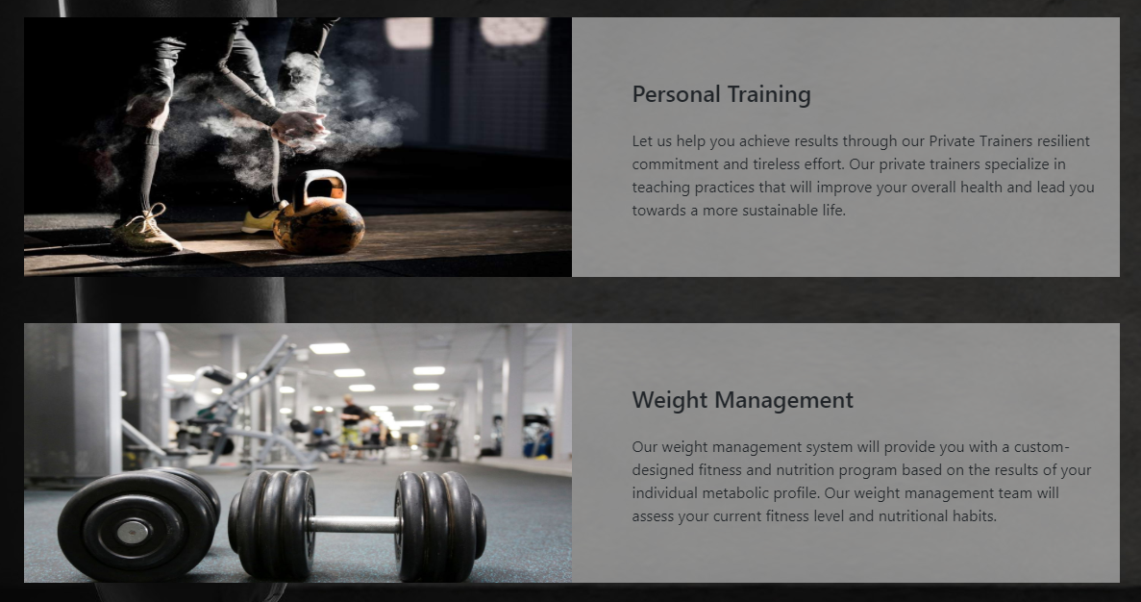

Slide 13

We have expert trainers

Slide 14


Slide 15


Slide 16


Slide 17
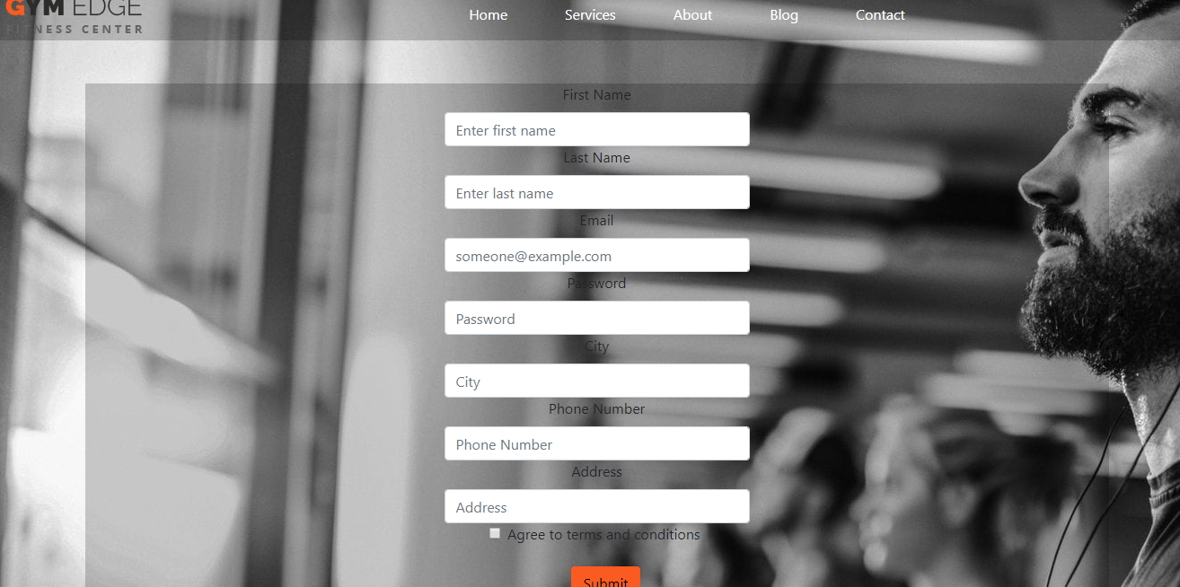

Slide 18


Slide 19

Get a discount

Slide 20
Application Requirements
User Interface:
Application:
HTML has been used for developing the user layout for the system.
PHP and JavaScript has been used for creating all the validations and client side scripting functionality.
CSS has been used for designing the web page of the system.
Client on Internet: Web Browser, Operating System (Any)
Web Server: Apache
Database: MySQL
Markup Language: HTML, CSS
Scripting Language: PHP, JavaScript, JQuery
AJAX

Slide 21
CONCLUSION:
The “GYM EDGE MANAGEMENT SYSTEM” is successfully designed and developed to fulfilling the necessary requirements, as identified in the requirements analysis phase, such as the system is very much user friendly, form level validation and field level validation are performing very efficiently. The old manual system was suffering from a series of drawbacks. The present project has been developed to meet the aspirations indicated in the modern age.

Slide 22
THANKYOU!
ANY SUGGESTION?

